Slide 1



BASIC DETAILS OF THE TEAM
Insert college logo
Title of your Idea/Product: DRONE CLOUD-SEEDING
Team Name: SPARKLERS
Team Leader Name: PUJITHA.BOLISETTY
Institute Name: VISHNU INSTITUTE OF TECHNOLOGY
Institute Affiliation: JAWAHARLAL NEHRU TECHNOLOGICAL UNIVERSITY KAKINADA

Slide 2
IDEA
Drone Cloud-Seeding is a modern technology that involves the use of unmanned aerial vehicles to disperse seeding agents into clouds in order to reduce rainfall . This innovative approach offers a more cost effective and efficient method of weather modification compared to traditional ground-based methods .
PROCESS
Clouds suitable for seeding are identified. These are typically clouds with enough moisture but insufficient natural process to trigger precipitation. Substances like silver iodide , salt, dry ice are used . These acts as “nuclei” around which water vapour can condense.
These are equipped with flares containing seeding materials are released into clouds The particles encourage the condensation of water vapour around them , forming ice crystals or water droplets . The droplets combine and grow larger and become heavy enough , they fall as rain or snow . This can increase rainfall in drought – prone areas or control the timings of precipitation .

Slide 3
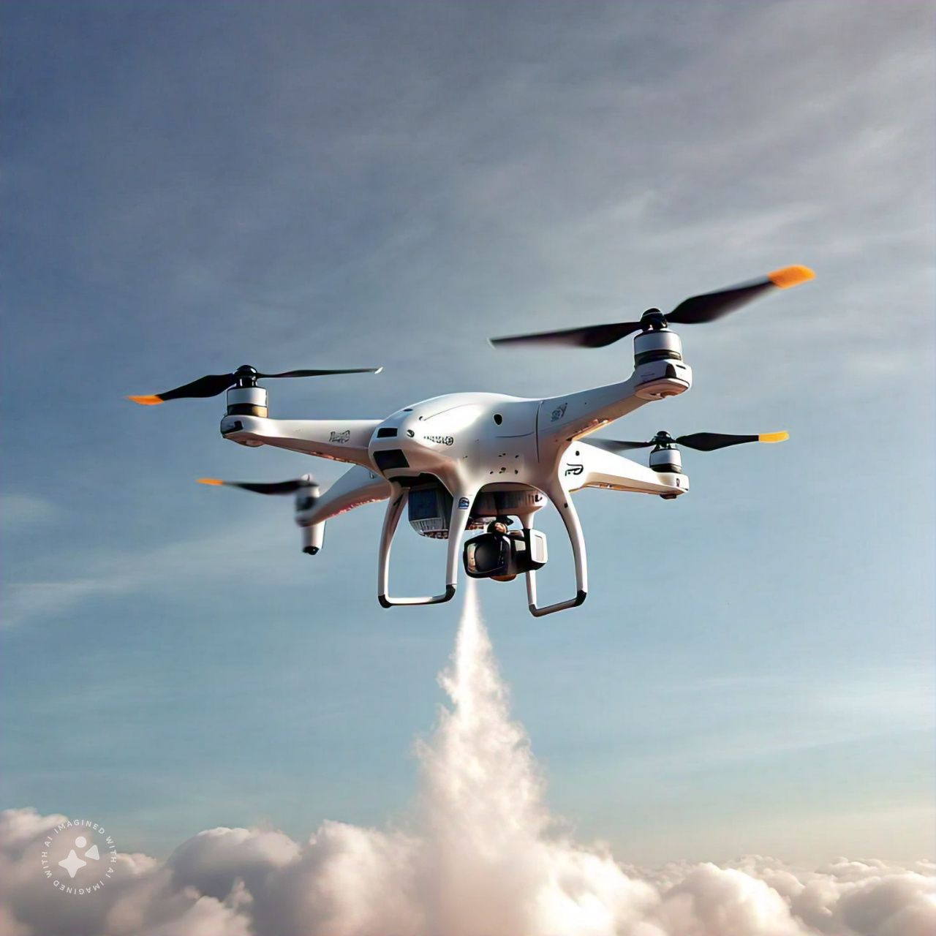
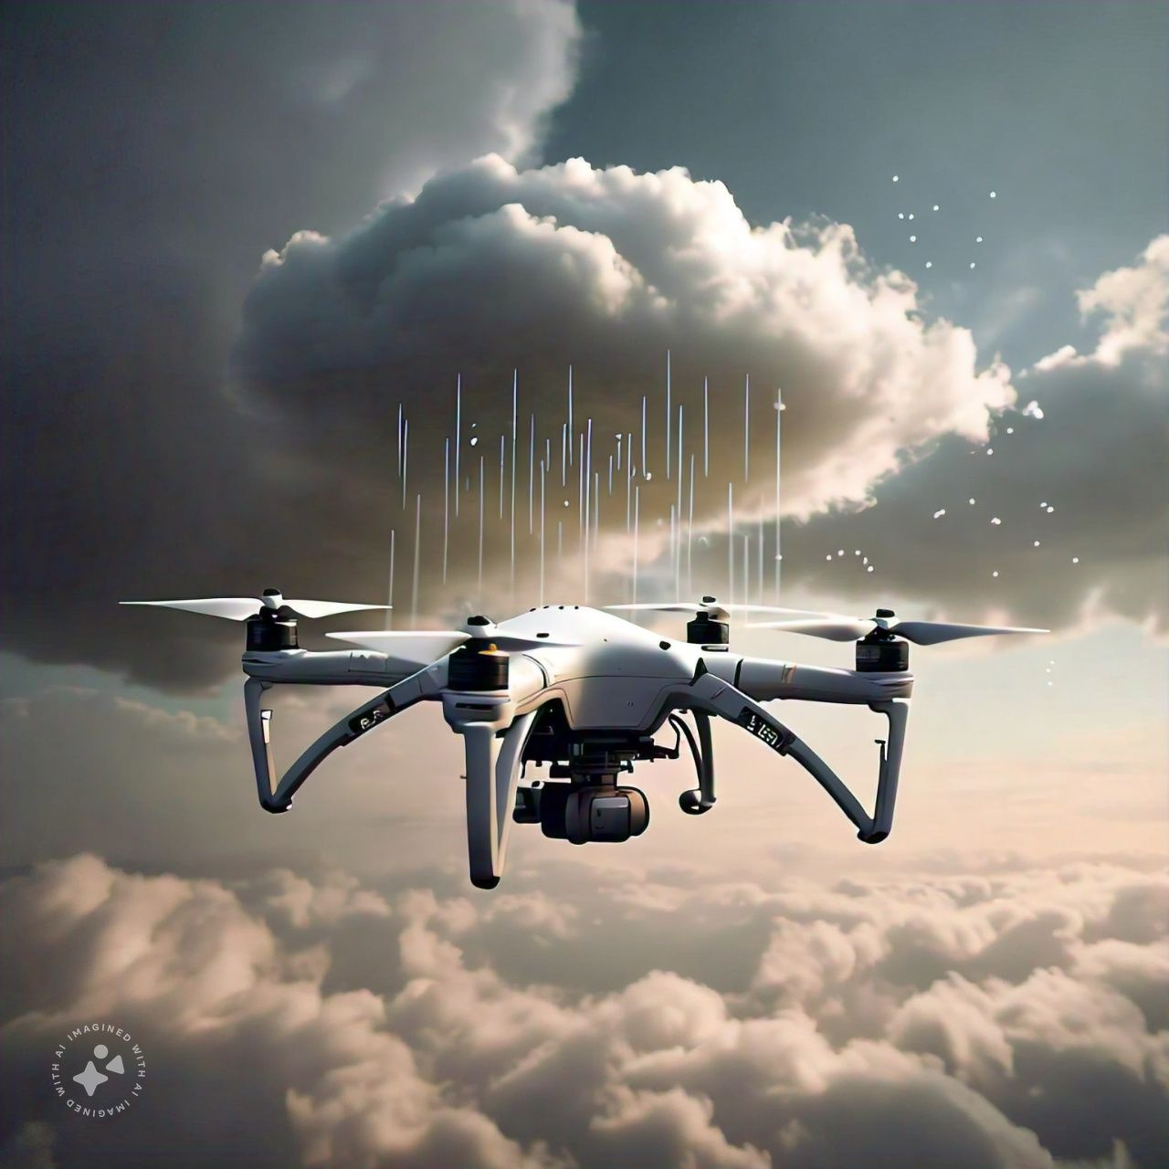
APPLICATION OF IDEA/USE CASE
REDUCED RISK
The use of drones for cloud seeding reduces the need for human pilots to fly throw potentially hazardous weather conditions . This decreases the risk of accidents and ensures the safety of person .
ACCESSIBILITY AND SAFETY
Drones are able to access hard-to-reach or dangerous areas that traditional methods may not be able to reach . This allows for cloud seeding to be conducted in a wider range of locations
EFFICIENCY AND PRECISION
Using drones for cloud seeding offers increased precision and accuracy in targeting specific areas for rainfall . This can result in more efficient water distribution and better crop yields .

Slide 4
TEAM MEMBER DETAILS
Team Leader Name: Bolisetty.Pujitha
Branch : Btech Stream : iNF Year : I
Team Member 1 name : Bolisetty .Pujitha
Branch : Btech Stream : INF Year : i
Team Member 2 Name: Madasu .Chandana deepthi
Branch : Btech Stream :INF Year : i
Team Member 3 Name: Gurram.Thanmai
Branch : Btech Stream : EEE Year : I
Team Member 4 Name: Karri . Sai lakshmi Gayathri
Branch : Btech Stream : INF Year : I
Team Member 5 Name: Velagala . Naga Swathi Reddy
Branch :Btech Stream : ECE Year : I
Team Mentor 1 Name : Dr .O. Ranga Rao
category: Academic expertise : phd Domain experience : 13 Years

